Slide 1

SKAPS Industries India pvt ltd, SEZ, Mundra (Unit 2)
~Established in 2012 ~
IIoT pilot project
Under the guidance of
Mr. Amit Thakkar (Plant head – Unit 2)

Slide 2


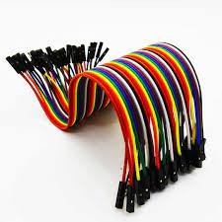
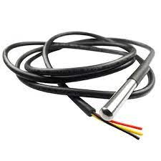

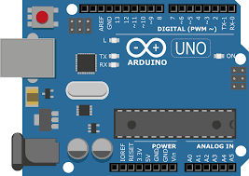




Project 1- Developing mobile application for receiving temperature update of E-house (Nonwoven Unit-2)
Used to sense temperature
App development
Broadband
Jumper wire
DS18B20
NODE MCU(ESP8266)
Software used to write, compile, and upload code to Arduino boards
Arduino board
Frontend development
Backend development

Slide 3
Step:1
Connect the DHT sensor to the NodeMCU board and set up I2C communication between the NodeMCU and Arduino.
Step 2: Program the NodeMCU
Using the Arduino IDE install the code into NodeMcu ,DHT sensor sense the temperature and send the data to the Node MCU
Step 3:
Program the Arduino
code for the Arduino to receive the temperature data from the NodeMCU via I2C and then format it as JSON data.
Step :4
Using Nodejs read the JSON DATA and store the data to the database, when the temprature is reach at high level then notification send via email, phone message, app notification
Step :5
the data inside the database fetch using Nodejs API And show in the React Native

Slide 4
Thank you

